Slide 1


Session No.:3 : Understanding the Memory process, Problems in retention, Memory enhancement techniques Course Name: Design Thinking Course Code:R1UC301L Instructor Name: Anita Thakur

Slide 2
SESSION OUTLINE
Understanding the Memory Process
Causes of Retention Problems
Memory Enhancement Techniques
Learning Outcomes

Slide 3
At the end of this s LEARNING OUTCOME ession students will be able to
•Students will be able to identify the stages of the memory process.
Students will be able to apply memory enhancement techniques in academic and design thinking contexts

Slide 4
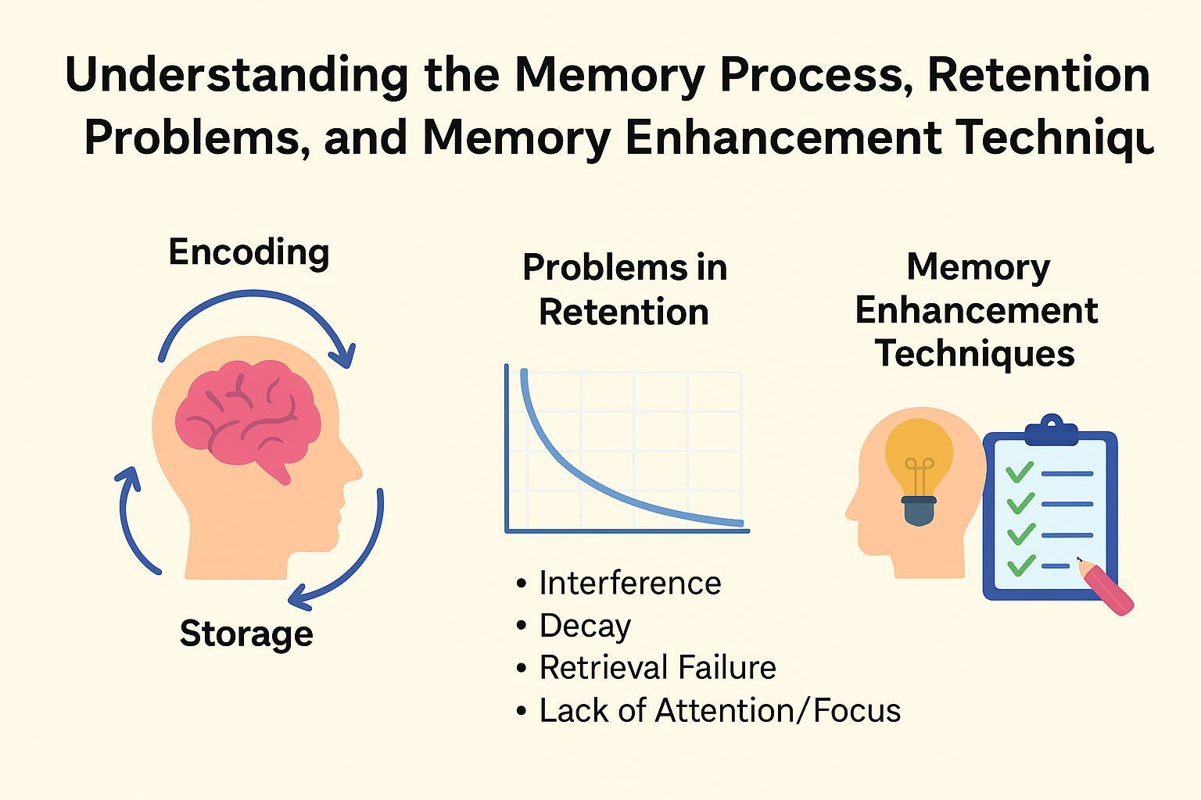
Reflect on the responses of post session activity
Look carefully at the body language picture for 20 seconds. After the time is over, write down what you understand.

Slide 5
Understanding the Memory process, Problems in retention, Memory enhancement techniques
Encoding: Converting information into memory trace.
Understanding Memory Processes:
Encoding: Converting information into memory trace.
Storage: Retaining information over time.
Retrieval: Accessing stored information when required.

Slide 6
Types of Memory
Sensory Memory – very brief, initial input.
Short-Term Memory (STM) – limited capacity, holds info temporarily.
Long-Term Memory (LTM) – durable, vast storage.
Working Memory – actively processing current information.
.

Slide 7
Problems in Retention
Interference: New information conflicts with old.
Decay: Memory weakens due to disuse.
Retrieval Failure: Stored information cannot be accessed.
Lack of Attention/Focus: Poor encoding of information.
Stress & Overload: Cognitive burden reduces retention.

Slide 8
Learning Activity 1 : THINK-PAIR SHARE
Activity 1: Why We Forget (Think–Pair–Share)Time: 10 minutes
Instructions:Think–Pair–Share:
Think: Recall a situation when you forgot something important. Give them 1–2 minutes to think individually.
Pair: Discuss with your partner why it happened. (3–4 minutes)
Share: Present your examples with the class. (4–5 minutes)

Slide 9
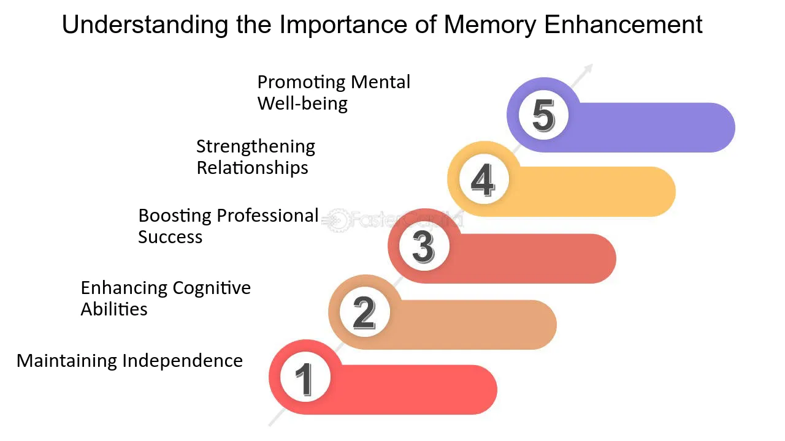

Slide 10
Memory Enhancement Techniques:
Mnemonics: Using acronyms, rhymes, and other memory aids to encode and retrieve information.
Chunking: Grouping related pieces of information together to improve memory span.
Elaboration: Connecting new information to existing knowledge or creating vivid mental images.
Repetition: Regularly reviewing information to strengthen memory traces.
Spaced Repetition: Reviewing information at increasing intervals to optimize learning.
Active Recall: Testing yourself on the material rather than passively rereading.
Mind Mapping: Visually organizing information to enhance understanding and recall.

Slide 11
Application in Design Thinking
Use mnemonics & visualization for idea retention.
Apply mind mapping for brainstorming.
Practice spaced repetition to remember design principles.
Enhance creative recall during ideation sessions.

Slide 13

Reflection Time: Quick Quiz
Let’s see what we have grasped.

Slide 14
UPCOMING SESSION
Problems in retention, Memory enhancement techniques, Understanding Emotions: Experience & Expression

Slide 15
THANK YOU !

